Slide 1

Department of Veterans Affairs
Hampton VAMC
Suicide Prevention Efforts

Slide 2

Our Challenge
Suicide is a public health challenge that causes immeasurable pain among individuals, families, and communities across the country. Suicide is also preventable. Veteran suicide is an urgent issue that the U.S. Department of Veterans Affairs (VA), along with its stakeholders, partners, and communities nationwide, must address. VA supports the national goal of reducing the annual suicide rate in the U.S. 20 percent by the year 2025 and is implementing a public health approach to achieve this mission.
An average of 20 Veterans die by suicide each day. Only six of the 20 are recent or registered users of Veterans Health Administration services. To serve all Veterans, the Hampton VA must build effective networks of support, communication, and care within our medical center and across the communities in which Veterans live and work every day.

Slide 3
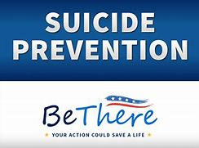
Suicide Prevention 2.0 -
Public Health Model
Seeks to answer the foundational questions: Where does the problem begin? And how could we prevent it from occurring in the first place?
Comprehensive multifaceted approach that reaches across sectors, including faith communities, employers, schools, and healthcare organizations, for example, to reach veterans where they live, work, and thrive
To localize its public health approach to suicide prevention, VA is creating integrated, interdisciplinary suicide prevention teams that will coordinate comprehensive and upstream interventions across VA and in communities nationwide. This strategy will broaden the organization’s current focus from high-risk Veterans Health Administration (VHA) users to all Veterans and their communities.

Slide 4
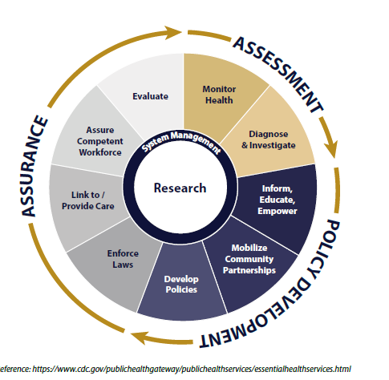
Public Health Model

Slide 5






Slide 6
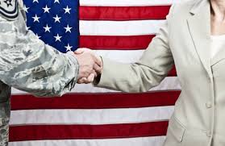
Community Partnerships and
Prioritized Stakeholders
Law Enforcement and First Responders
Local Government Agencies
Community Service Boards
Department of Human Services
Faith-Based Organizations
Gun Shops
Hospitals and Community Treatment Providers
Veteran’s Services Organizations
Active Duty (Navy, Army, Air Force Fleet and Family Service Centers)
Governor’s Challenge – VISR
Educational Institutions

Slide 7

Facility-Wide
“Suicide Prevention is Everybody’s Business”
Implement best practices to improve health and prevent suicide
Implementation of suicide prevention initiatives facility-wide and selective areas (e.g. ED, MH, Specialty Clinics)
Developing a multi-disciplinary and wholistic approach to enhanced care
Ongoing training for staff to support suicide prevention efforts
Telehealth and virtual applications
Use of other Technology and Social Media platforms

